Slide 1
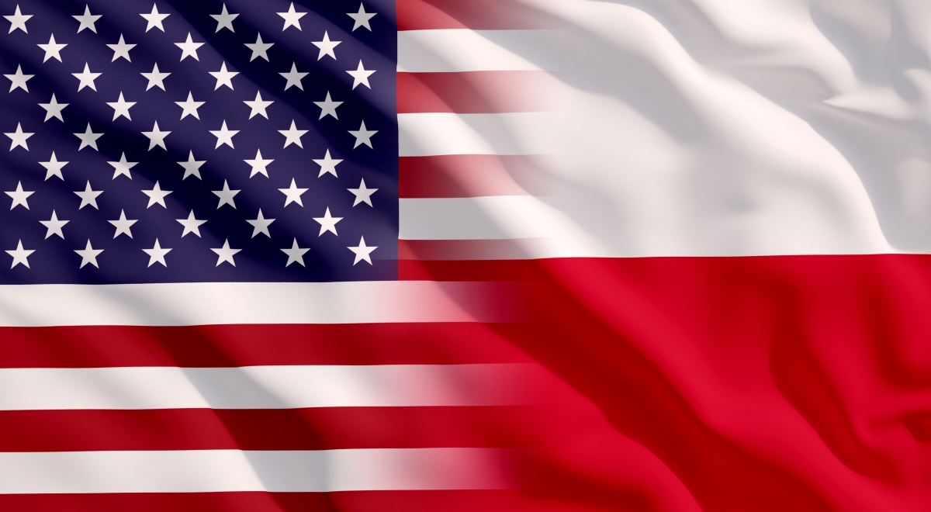
Famous Poles in the USA

Slide 2
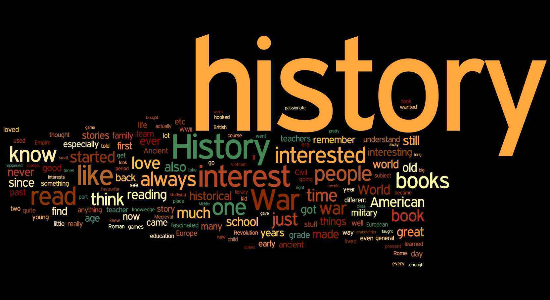
Historical figures

Slide 3
Tadeusz Kościuszko
Tadeusz Kościuszko was born on February 4, 1746. in the Mereczowszczyzna region, died on October 15, 1817. in Solar. He was a military, Polish and American general, as well as a national hero of these countries. He graduated from the Knights' School. He fought for the freedom of the United States. He organized the anti-Russian uprising after the Second Partition of Poland, called the Kościuszko Uprising from his name. Tadeusz Kościuszko occupies a leading position in the pantheon of Polish national heroes. The Kosciuszko Mountain was discovered and captured on March 12, 1840 by a Polish traveller and discoverer Paweł Edmund Strzelecki and named by him in honor of the memory of General Tadeusz Kościuszko. It is located in New South Wales, in the Kosciuszko National Park.

Slide 4
Kazimierz Pułaski
Pulaski is remembered as a hero who fought for independence and freedom in both Poland and the United States.
Born in Warsaw and following his father's footsteps, he became interested in politics at an early age and soon became involved in the military and the revolutionary affairs in Poland (the Polish–Lithuanian Commonwealth). Pulaski was one of the leading military commanders for the Bar Confederation and fought against Russian domination of the Commonwealth. When this uprising failed, he was driven into exile. Following a recommendation by Benjamin Franklin, Pulaski immigrated to North America to help in the cause of the American Revolutionary War. He distinguished himself throughout the revolution, most notably when he saved the life of George Washington. Pulaski became a general in the Continental Army, created the Pulaski Cavalry Legion and reformed the American cavalry as a whole. At the Battle of Savannah, while leading a daring charge against British forces, he was gravely wounded, and died shortly thereafter.

Slide 5
Włodzimierz Krzyżanowski
A Polish-born American engineer, politician, and military leader — during the American Civil War, a brigadier general in the Union Army.
After the Civil War, he held several government posts, though not as the first American administrator of Alaska Territory, as is often thought.

Slide 6
Business people

Slide 7
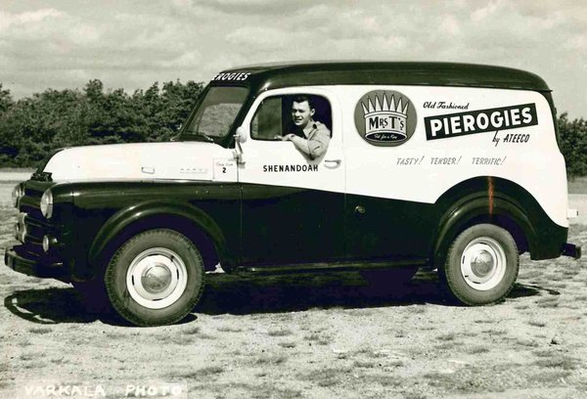
Theodore F. "Ted" Twardzik
Theodore F. "Ted" Twardzik born Sept. 7, 1927 to parents Frank and Mary (Binek) Twardzik who emigrated from Poland, passed away on Nov. 10th, 2016. Ted was the youngest of six children. After college, Ted's first job was as a staff accountant for Arthur Andersen & Company in New York City, NY, one of the prestigious "Big Eight" accounting firms of its time. In 1952, Ted decided to return home to Shenandoah to pursue his entreprenurial dream to start a food company using his mother Mary's recipe for pierogies. He remembered how popular the traditional Polish dumplings were at Church Festivals and thought people would buy them at a grocery market. To honor his mother the brand became Mrs. T's®. Ted started with 5 women from Poland around the kitchen table in his mother's home.

Slide 8
Reuben Mattus
The history of some of the most famous and at the same time most expensive ice cream in the world begins in the1920s in the United States. It was then that a Polish emigrant of Jewish origin entered into a sweet business. The Polish-born Reuben Mattus arrived in New York with his widowed mother. While she was making kosher ice creamin the small Bronx factory of their Italian cousin, Reuben distributed it in neighbouring shops and restaurants in a horse wagon. In 1932, he took over the family business.
In search of newtastes and recipes, he studied relevant literature, because as he said, "the most important thing is that ice cream tastes good". While the competition, in the name of cost reduction, produced icecream from non-fat milk powder and artificial flavours, Reuben, remaining faithful to traditional family recipes, used fresh yolks, real cream and Belgian chocolate, vanilla beans from Madagascar and coffee from Colombia. He made three basic flavours: coffee, chocolate and vanilla.

Slide 9
Barbara Piasecka-Johnson
Barbara Piasecka-Johnson (25.02.1937-01,04,2013)- Polish and American professor of history of art; after studies in Rome, she went to USA, where she was working for her future husband as a maid, she was the third John Seward Johnson's wife; he was a founder and producent of the American pharmaceutical and cosmetic company- Johnson&Johnson

Slide 10
Max Factor
Max Factor (Maksymilian vel Michaił Faktor vel Faktorowicz) (19.02.1872-30.08.1938) - Polish and Jewish producent and founder of first cosmetics; founder of cosmetics company ,,Max Factor''; when he was a teenager, he was a helper in a hairdressing studio; in 1904 he went to the USA and stayed there

Slide 11
Helena Rubinstein
(Chaja Rubinstein) (25.12.1872-01.04. 1965) - Polish and Jewish businesswoman, founder of company ,,Helena Rubinstein Itc.'', one of the richest women in the world; she started production of ,,Valaze cream, which wasn't her idea, but she got rich thanks to it; she went to the USA with family and she stayed there

Slide 12
Steve Wozniak
Stephen Gary Wozniak (born on August 11, 1950), is an American inventor, electronics engineer, programmer, philanthropist, and technology entrepreneur who co-founded Apple Computer. Steve Wozniak was born in San Jose, the son of Francis Jacob "Jerry" Wozniak and Margaret Louise Wozniak.Jacob Francis Wozniak, called Jerry, had Polish and German roots (Steve's great-grandfather was born in the 19th century in Poland)

Slide 13
Jack Tramiel
Jack Tramiel- Jacek Trzmiel (December 13, 1928 – April 8, 2012) was a Polish - American businessman, best known for founding Commodore International. The Commodore PET, Commodore VIC-20 and Commodore 64 are some home computers produced while he was running the company. He and his wife Helena had three sons: Sam, Leonard and Gary, who worked with him in the company. The bumblebee survived many times - a brutal Jewish ghetto and a shipment to the Nazi death camp in Auschwitz. As Josef Mengele was declared able to work, he was transferred to Hanover, where he was liberated by the Allies in 1945. Two years after the war, Tramiel emigrated to the United States. Causative of death: Heart failure.

Slide 14
Leo Gerstenzang
Leo Gerstenzang (June 3, 1892 – 1 October, 1973) was a Polish born American who in 1923 invented the cotton swab or Q-Tips. His product, which he named "Baby Gays", went on to become one of the most widely sold brand names. There are many anecdotes about how Gerstenzang came to create this invention. One is: “One day in 1923, Leo Gerstenzang found himself watching his wife, Ziuta, applying cotton wads to toothpicks in an attempt to reach hard-to-clean areas. Gerstenzang, inspired, soon produced a one-piece cotton swab.”

Slide 15
Warner Bros
Warner Bros is one of the world's largest producers and distributors of film and television productions. The factory was founded by the Warner brothers: Alberta (born 23.07.1884, Krasnosielc, d. 26.11.1967, Miami Beach, wives: Bessie Siegal (1925-1967), Bessie Krieger (1908-1923)), Sama (born 10.08.1887 Krasnosielc, d. 05.10.1927 in Los Angeles, wife of Lina Basquette (1925-1927) child of Lita Warner) and Harry (born 12.12.1881, Krasnosielc, d. 25.07.1958, Los Angeles, married to Rea Levinson (1907-1958)), a Polish Jewish immigrant born in Krasnoslec, Makowski District, Mazovia, as: Aaron, Szmul, Hirsz Wonsal, and Jack, born as Itzhak Wonsal in Canada. The brothers, pledging the family property: a horse named Bob and selling their father's watch, gained capital, which they used for the purchase of the projector.

Slide 16
Actors / Actresses

Slide 17
Scarlett Johansson
Scarlett Ingrid Johansson was born November 22, 1984 in New York City.
She is an American actress and singer.
Scarlett has a daughter with her
former husband, Romain Dauriac.
Scarlett’s mother, who is American-born, is Polish Jewish
Scarlett’s great-great-uncle Mosze Szlamberg, was killed in the Holocaust in Poland, along with at least two of his children, Zlata and Mandlit.
After World War II, Scarlett’s family moved from Poland to USA
Scarlett discovered her Polish roots in TV program „Finding your roots” and after that she told that tragic information made her closer with her family

Slide 18
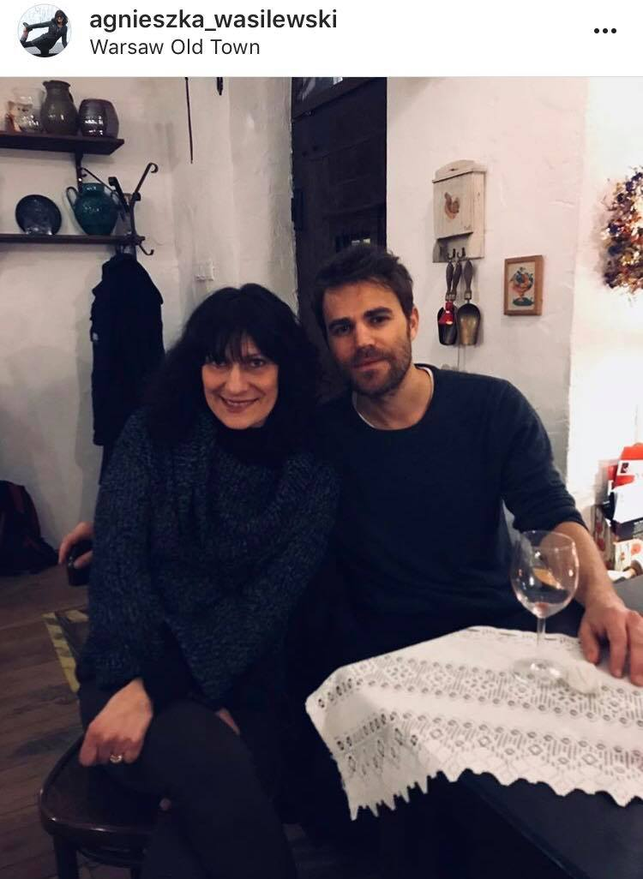
Paul Weasley
Pawel Tomasz Wasilewski was born July 23, 1982.
He known professionally as Paul Wesley and formerly as Paul Wasilewski.
He is an American actor, director, and producer.
Wesley was born in New Brunswick, New Jersey, to Polish parents Tomasz and Agnieszka Wasilewski, and grew up in Marlboro Township, New Jersey. He has one older sister, Monika Emara (née Wasilewski) and two younger sisters, Leah and Julia Wasilewski.
In addition to English, he speaks Polish, having spent four months every year in Poland until the age of 16.
He often visits his grandparaents in Poland in Warsaw with his mother.

Slide 19
Peter Falk
Peter Michael Falk was born September 16, 1927 and died June 23, 2011.
He was an American actor.
Both of his parents were Jewish, coming from Poland and Russia on his father's side and from Hungary and Labowa, Nowy Sacz, Poland, on his mother's side.
Falk's mother is Russian and his father was Polish, with a mix of Hungarian and Czech further back in their ancestry. So, contrary to Falk's public image, he is not an Italian but a mixture of very hardy Eastern European stock.

Slide 20
A TV presenter

Slide 21
Rita Cosby
Rita Cosby, a famous Polish American
Rita Cosby (born November 18, 1964, Brooklyn, New York) is a television news anchor and correspondent, radio host, and best selling author.
She is the daughter of a Danish mother and a Polish father Richard Cosby (Ryszard Kossobudzki) who came to the United States after World War II.
Rita wrote a best-selling book ‘Quiet Hero - Secrets From My Father’s Past’ about her father, Ryszard Kossobudzki’s role in the1944 Warsaw Rising.
She is currently a Special Correspondent for the CBS syndicated program Inside Edition specializing in interviewing newsmakers and political figures.
October 11, 2010, was declared "Rita Cosby Day" in the State of New York for her “extraordinary journalism and exemplary service on behalf of her community.”

Slide 22
Sportsmen

Slide 23
Tomasz Adamek
Tomasz Adamek (born December 1, 1976 in Żywiec ) - Polish boxer , former world champion of the International Boxing Federation (IBF) and International Boxing Organization (IBO) in the junior- heavy category and World Boxing Council (WBC) in the light-heavyweight category, medalist of the European Championship amateurs, international Polish champion. The winner of the 2nd place in 2005 and the fourth in 2006 in the plebiscite for the best Polish athlete. Founder of the sports club KS Cios-Adamek in Gilowice .
He is the first Pole to win the "Muhammad Ali Giant Athlete Award", the Muhammad Ali award for outstanding sports performance and posture outside the ring, as well as The Ring championship belt - the master belt of The Ring magazine.
InSeptember 2004, Adamek signed a contract with promoter Don King and left for the United States. He began training at the Chicago "Windy City Gym" with Gołota , under the supervision of coach Sam Colonna .

Slide 24
Marcin Gortat
Marcin Janusz Gortat (born February 17, 1984 in Łódź ) - Polish basketball player , juvenile of the Lodz Sports Club , representative of Poland , from the 2013/14 season the Washington Wizards fighter . As the only Pole in the history of the NBA, he advanced to the finals .

Slide 25
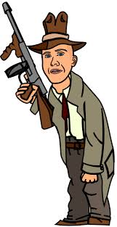
Gangsters

Slide 26
Henryk Wojciechowski - Earl Weiss
Henryk Wojciechowski - Earl Weiss was born in 1898 in north part of Chicago-Little Hell district. His parents were Poles. He was active during Al Capones life. Al Capone was acquainted with him and respected him.
As a teenager he established Northsiedrs gang. They were robbing jewellers and they were stealing cars. He was a Catholic. Near his gun he was wearing a rossary. During the prohibition in the USA the gang he belonged to attacked the transports of alcohol smugglers. They bribed policemans and councilors. Thanks for this they had their own bottling plants. They were the only distributors of Chicago Tribune newspaper.
Earl was killed when he was 28, 11th october 1926 by Al Capones people. The figure of Earl was in the serial Banned Empirie which tells the story of prohibition in the USA.

Slide 27
John Factor
John Factor (Iakov Faktorowicz) was born on 8 October,1892 in England. His half brother is famed cosmetics founder Max Factor. He was born the youngest of ten children. When Factor was a year old he was taken to Łódź and lived there until he was eleven. In the early 1900's, the family moved to St. Louis and later onto Chicago.
During the 1920's, Factor went into business with gangsters Arnold Rothstein and Al Capone. He ran a stock scam in England and swindled nearly $8 million out of investors and members of the royal family. He also broke the bank at Monte Carlo by rigging the tables.
When Factor died in 1984 in Los Angeles, he was a multi-millionaire and his funeral was attended by the likes of Tom Bradley – Los Angeles' Mayor and Edmund "Pat" Brown – former Governor of California.

